Slide 1
BE PROACTIVE (Warm-up) Monday -10/04- Complete on a new Warm-Up sheet.
Quickly sketch (no color) one object that you currently own and that you think someone might find 20,000 years from now.
Answer these questions about the object (write 2-3 sentences under the picture): Why was it made/how is it used? What could it tell someone about the people who use it?
http://www.youtube.com/watch?v=_Tl3AN-moMY

Slide 2
Early Humans Vocab. 1
Label your notebook paper as Early Humans Vocab. 1.
Put a 2 in the lower right hand corner.
As you go through the PowerPoint of words, copy each word onto notebook paper and underline the key words.
Pay attention to the pictures to help you get a better understanding of each term.

Slide 3
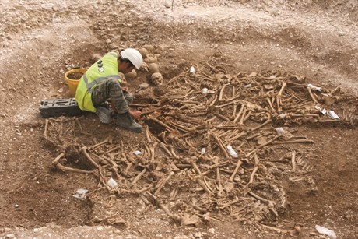
archaeology
the study of the past based on what people left behind

Slide 4
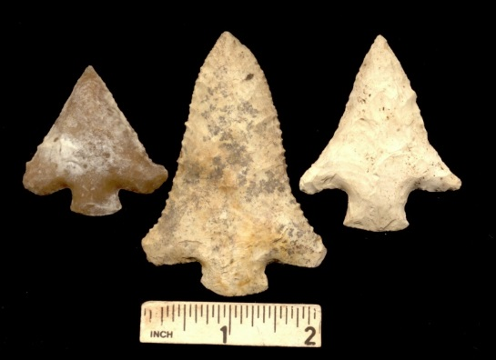
artifact
an object created and used by humans

Slide 5
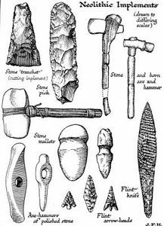
tool
an object that has been modified to help a person accomplish a task

Slide 6
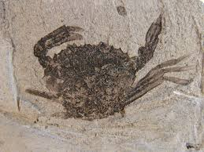
fossil
a part or imprint of something that was once alive

Slide 7
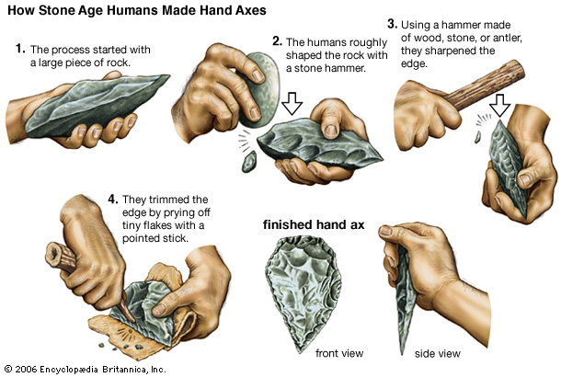
Paleolithic Era
the first part of the stone age when people first used stone tools

Slide 8
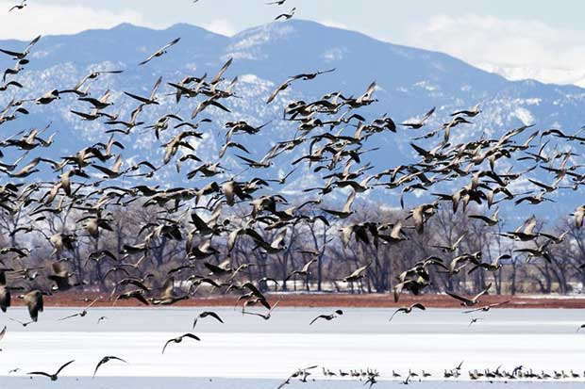
migratory
roving and wandering from time to time

Slide 9
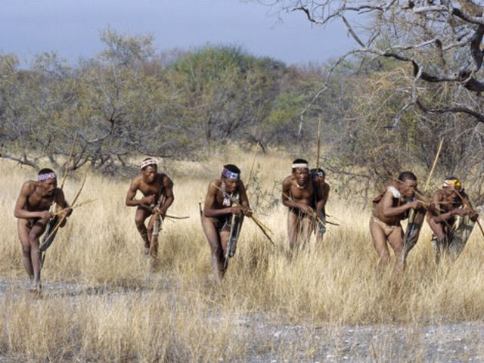
hunters-gatherers
people who chase/kill animals and collect plant goods to survive

Slide 10
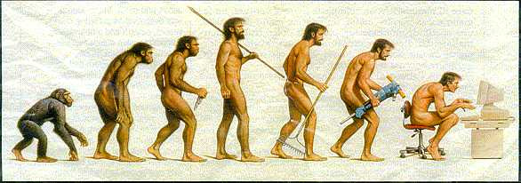
hominid/hominin
an early ancestor of humans

Slide 11
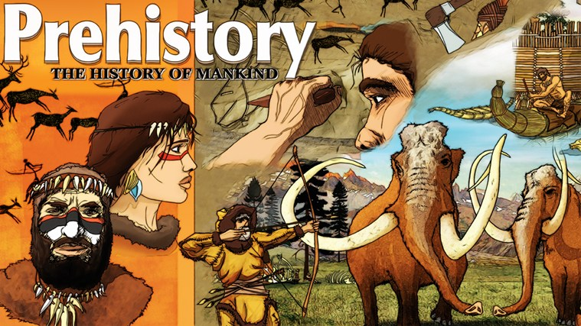
prehistory/prehistoric
the time before there was writing

Slide 12
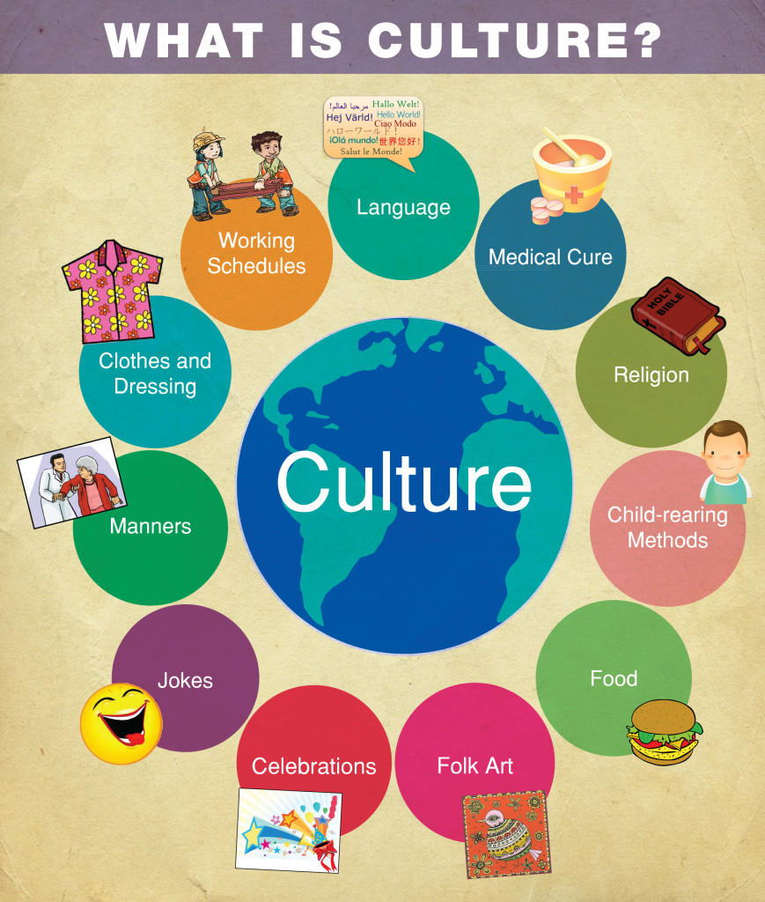
culture
the knowledge, beliefs, customs, and values of a group

Slide 13
Unit 2 Title Page- complete on notebook paper
Write the title (Early Humans) and your name in the middle of the page.
Pick 4 of your Early Humans Vocabulary words.
Draw a colorful picture of each of these 4 words; cover the entire paper with color (no white space).
Label each picture, showing which picture is for which Vocabulary word.
You may design your page and place your pictures however you think looks best and is most creative.

