Slide 1
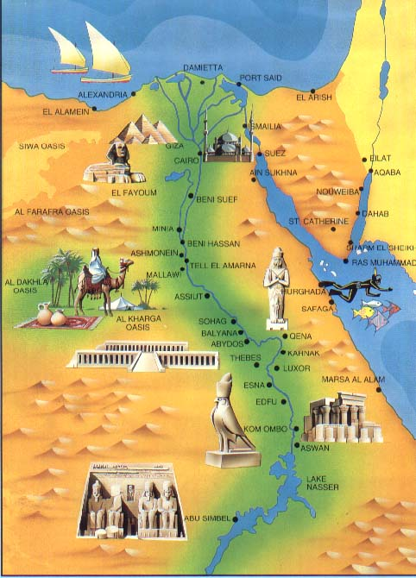
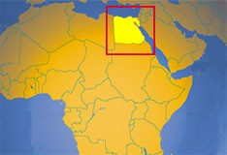
Ancient Egypt Vocabulary with Vocabulary Wheels

Slide 2
On notebook paper, split it in half. In each half, draw one of the Vocabulary Wheels seen below (only 2 per page). Then, as you go through the PowerPoint, copy your vocabulary words and definitions into the center oval. Pick one (1) of the other activities to complete around the center oval. You will need 2-3 sheets of notebook paper.
2 ANTONYMS/ NONEXAMPLES
3 SYNONYMS/ EXAMPLES
WORD/ DEFINITION
COLORFUL PICTURE
MEANINGFUL SENTENCE with word circled

Slide 3
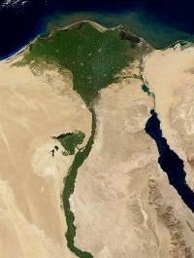
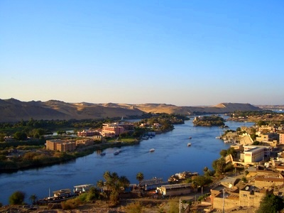
Nile River
longest river in the world; lifeblood of Ancient Egypt

Slide 4
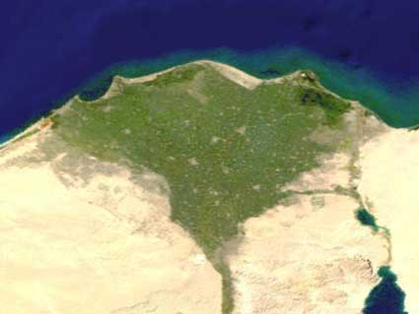
delta
triangle shaped land made of soil deposited by a river

Slide 5
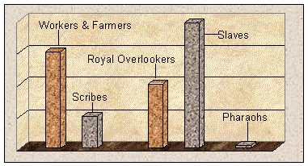
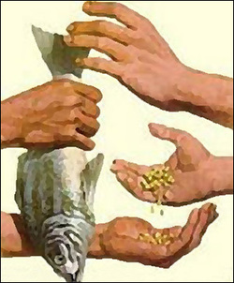
economy
the way a country uses resources to produce/sell/trade goods and services to meet people’s needs and wants

Slide 6
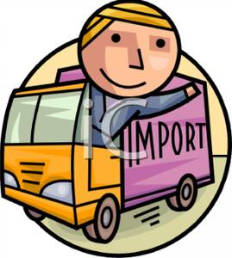
import
goods brought in to your area by other regions

Slide 7
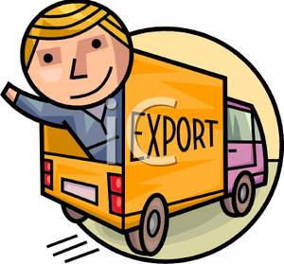
export
goods that exit (go out of) your area to other regions

Slide 8
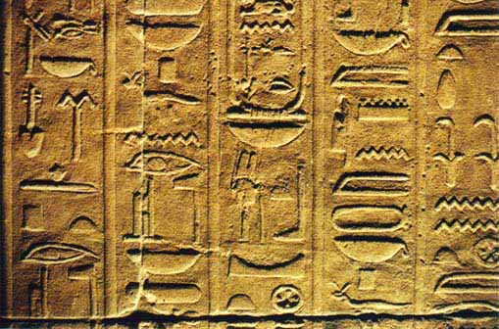
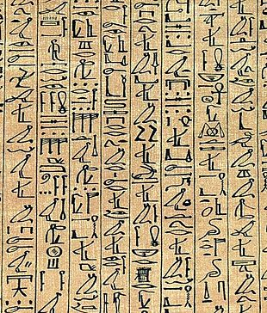
hieroglyphics
The Ancient Egyptian writing system

Slide 9
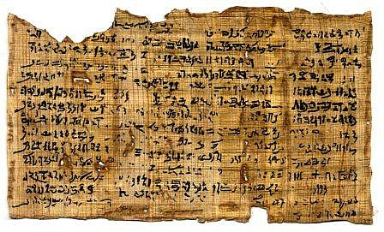
papyrus
a long-lasting paper-like material made from reeds in ancient Egypt

Slide 10
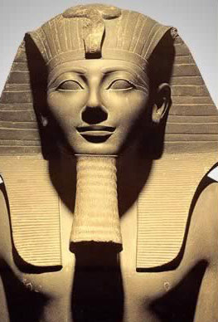
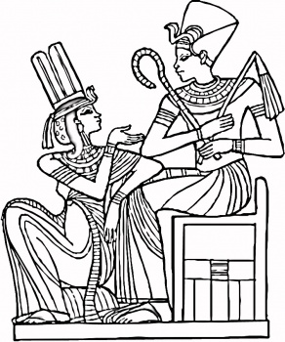
pharaoh
the title used by the rulers of Egypt

Slide 11
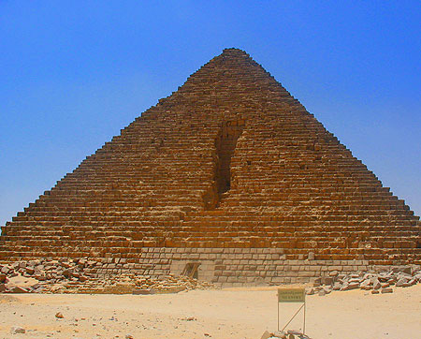
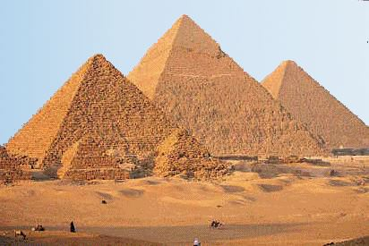
pyramids
large stone pointed structure with four triangle walls; used as tombs for the pharaohs and their queens

Slide 12
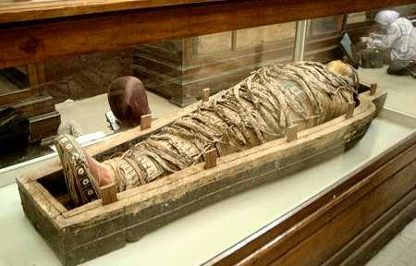
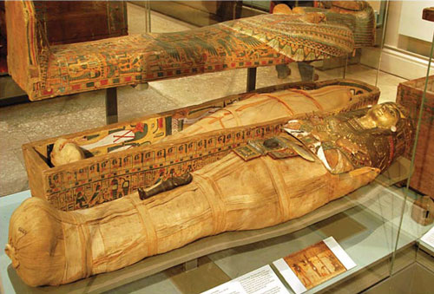
sarcophagus
a stone coffin, typically decorated with sculptures and words, used for housing a mummy

