Slide 1
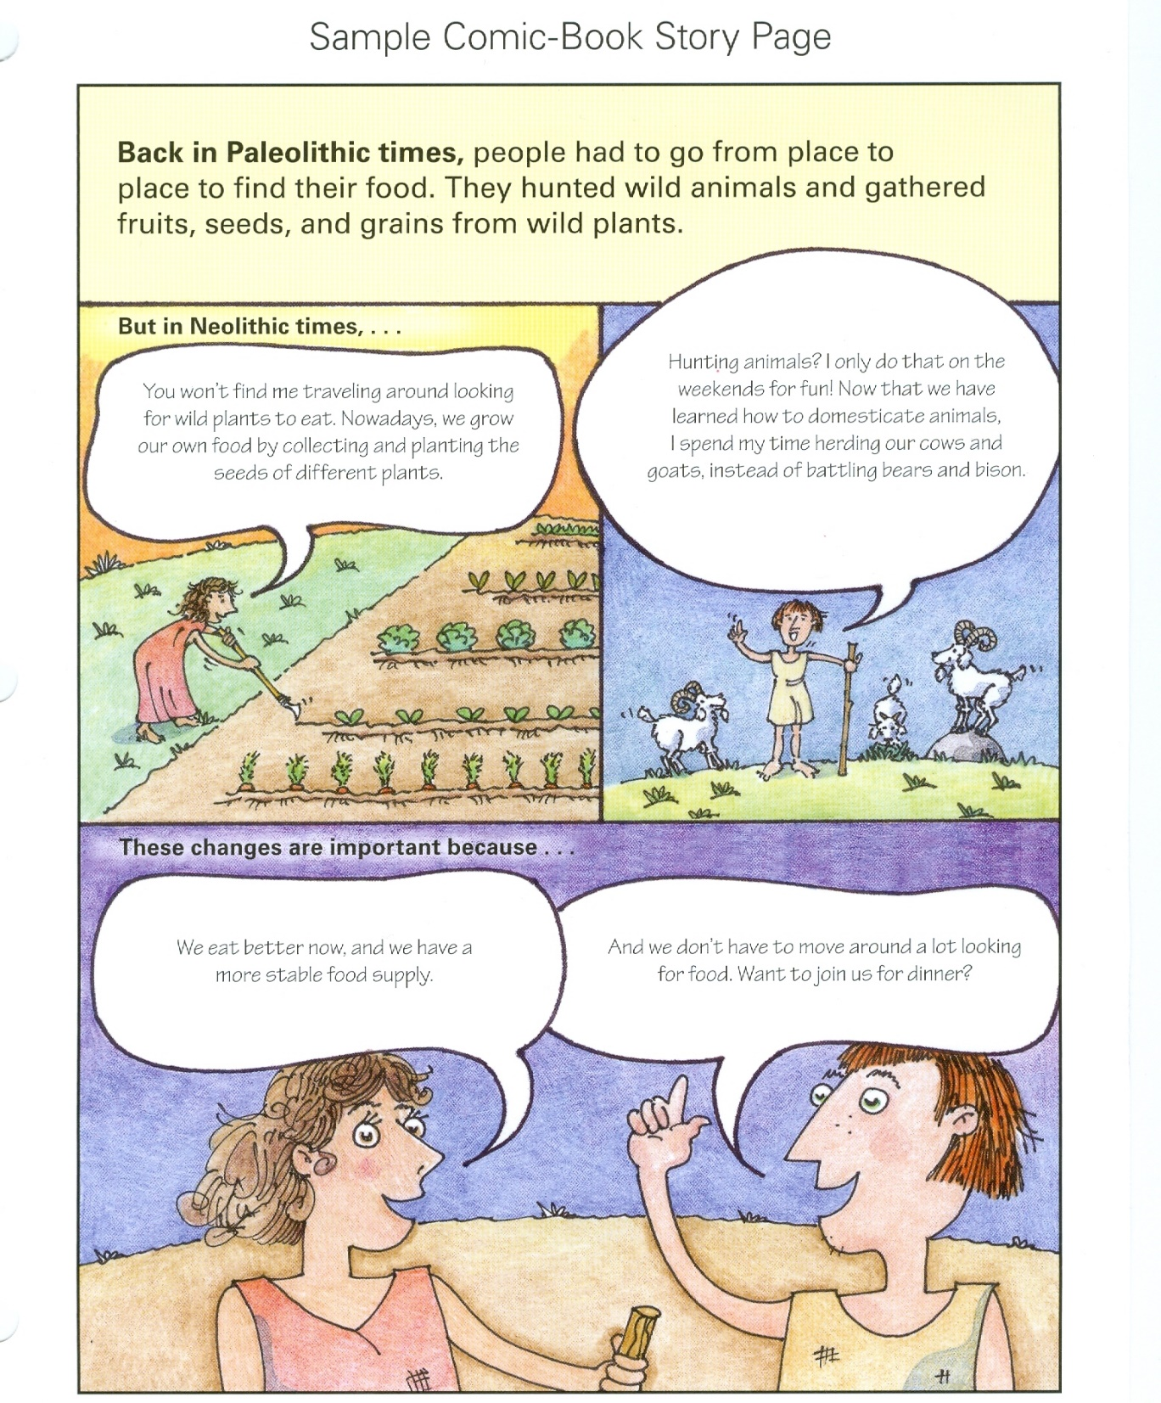
Things to note:
-Full color
-Each box shows a scene
-Use graphic organizer
-You will be assigned a page to complete.
-This is due tomorrow
-must be colored
-can type or handwrite
-must use cartoon characters
There will be a quiz tomorrow! Look at warm-ups and 2.2 worksheet!

