Slide 1


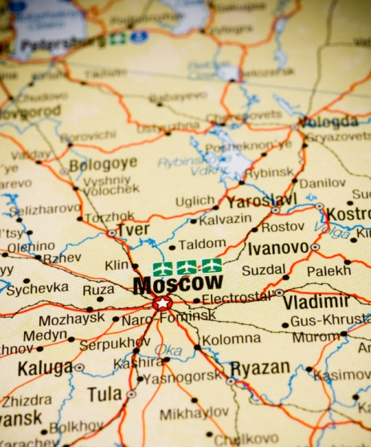
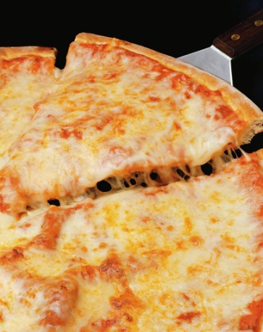
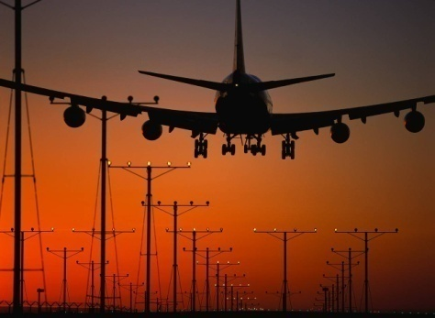
THE 5 THEMES OF GEOGRAPHY

Slide 2
Five Themes of Geography
Theme and description/questions | Types and Examples
Movement -
Regions -
Human-Environment Interactions -
Location -
Place -

Slide 3

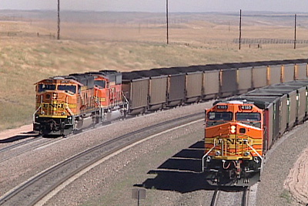
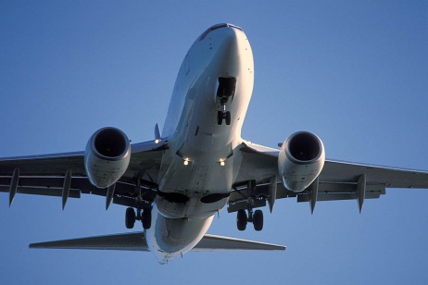


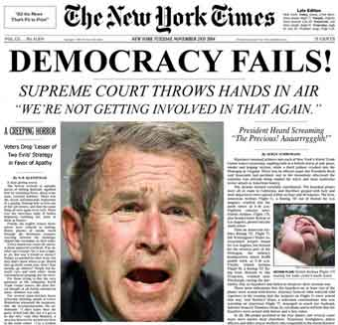
MOVEMENT
How are people, goods, ideas moved from place to place?
  Human Movement
    Trucks, Trains, Planes
  Information Movement
    Phones, computer (email), mail
  Idea Movement
    How do fads move from place to place?
    TV, Radio, Magazines

Slide 4
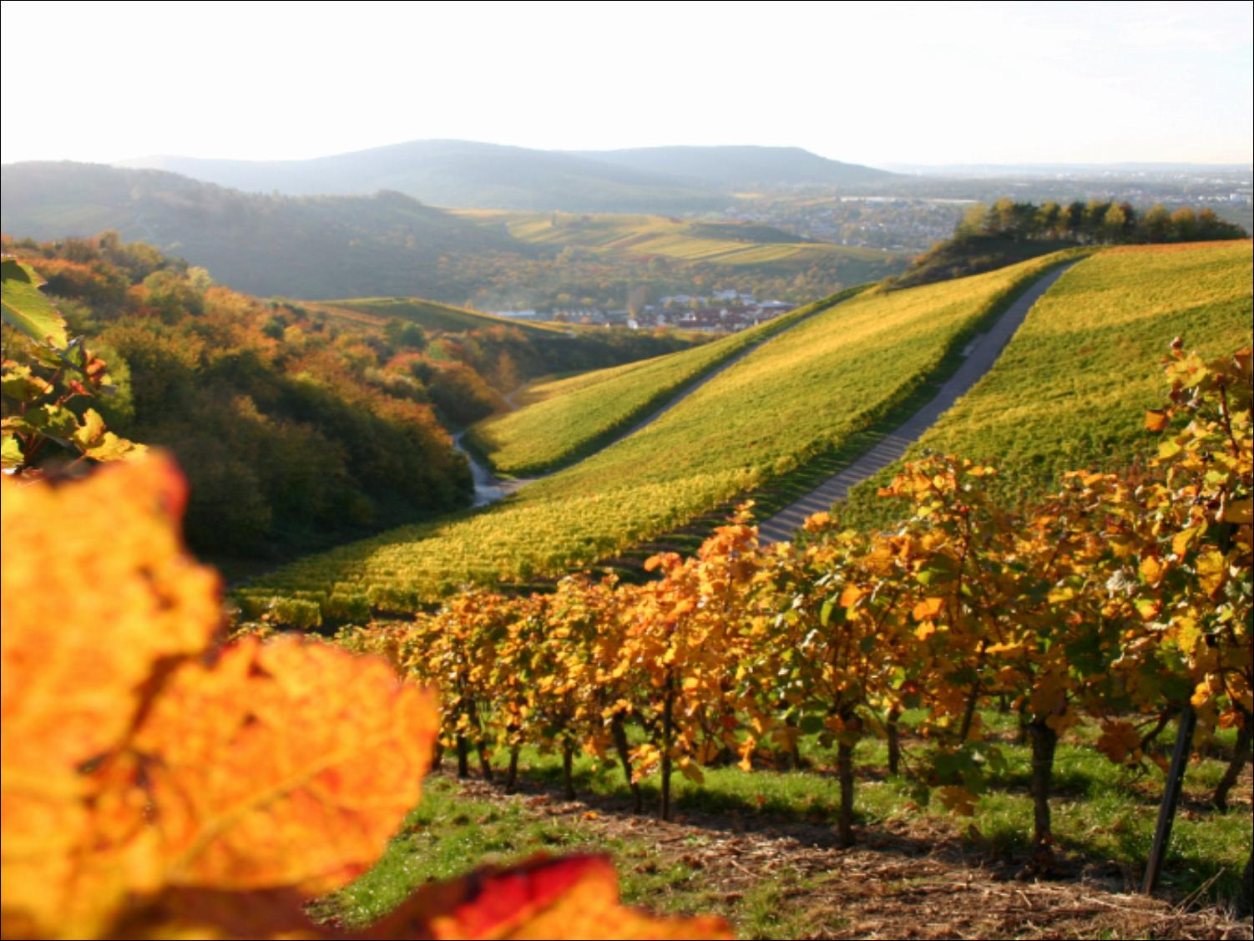
REGIONS
How are Regions similar to and different from other places? How places are grouped?
  Formal Regions
    Regions defined by governmental or administrative boundaries (States, Countries, Cities)
    Regions defined by similar characteristics (Corn Belt, Rocky Mountain region, Chinatown).
  Functional Regions
    Regions defined by a function (newspaper service area, cell phone coverage area).
  Vernacular Regions (Not in your book)
    Regions defined by peoples perception (middle east, the south, etc.)

Slide 5

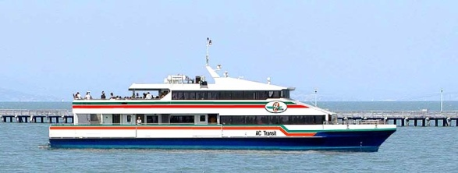
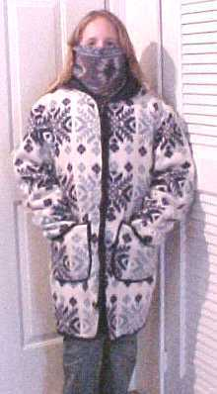

HUMAN-ENVIRONMENT INTERACTION
How do humans and the environment affect each other?
  We depend on it.
    People depend on the Tennessee River for water and transportation.
  We modify it.
    People modify our environment by
    heating and cooling buildings for comfort.
  We adapt to it.
    We adapt to the environment by wearing
    clothing suitable for summer (shorts) and
    winter (coats), rain and shine.

Slide 6
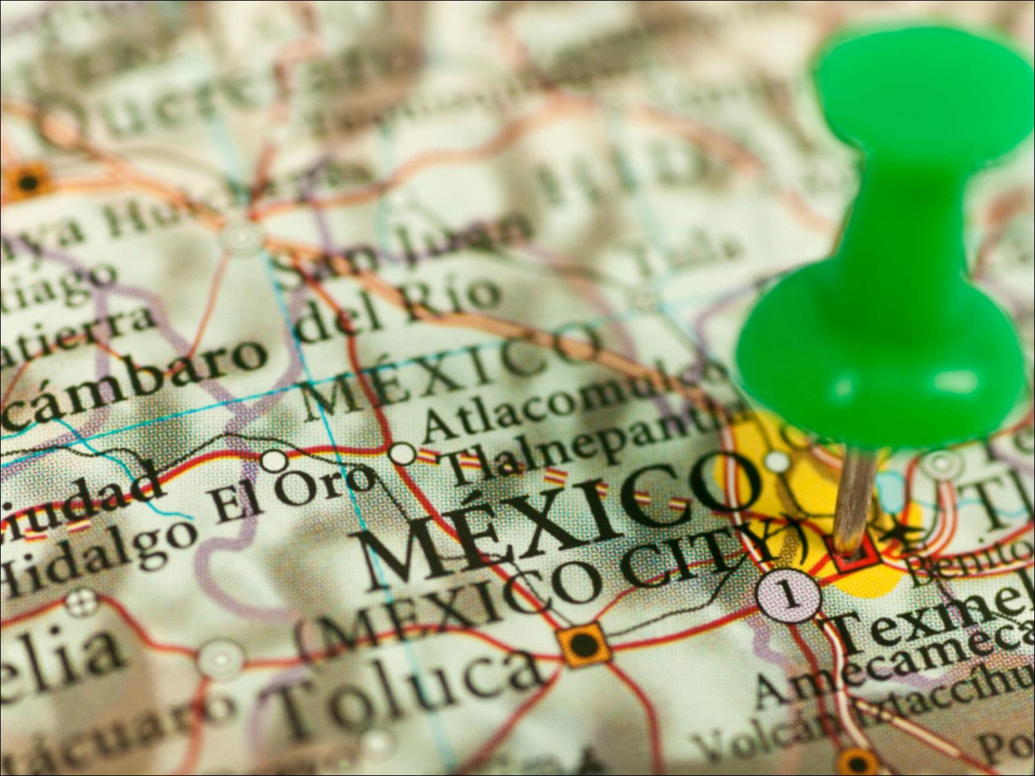
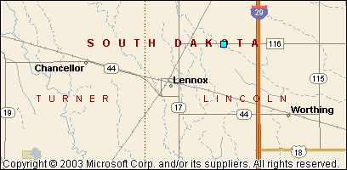
LOCATION
Where are we?
Absolute Location
  A latitude and longitude (global location) or a street address (local location).
      Paris France is 48º North Latitude and 2º East Longitude.
      The White House is located at 1600 Pennsylvania Ave.
Relative Location
  Described by landmarks, time, direction or distance. From one place to another.
      Go 1 mile west on main street and turn left for 1 block.
You are Here

Slide 7
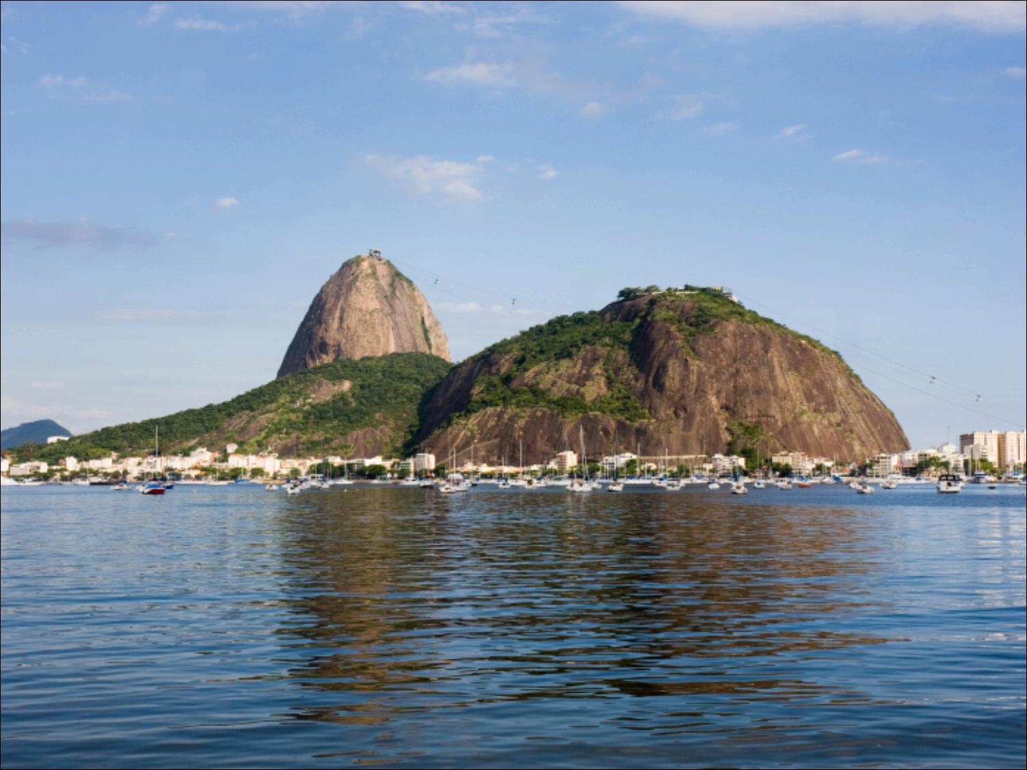
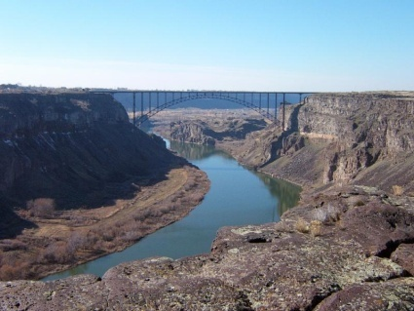
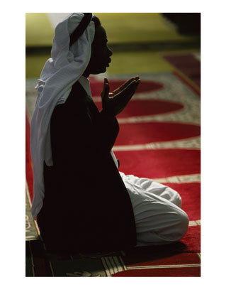
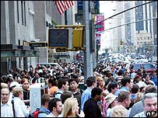

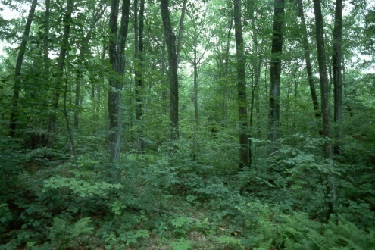
PLACE
What is it like there, what kind of place is it?
Human Characteristics
    What are the main languages, customs, and beliefs.
    How many people live, work, and visit a place (population).
Physical Characteristics
    Landforms (mountains, rivers, etc.), climate, vegetation, wildlife, soil, etc.

Slide 8
Remembering the 5 themes
If you can’t remember what they are just ask MR. HELP!!!
    M – Movement
    R – Regions
    HE – Human Environment interaction
    L – Location
    P - Place

Slide 9
http://youtu.be/AIqC79WrpKg

Slide 10
Your assignment
Complete your “5 Theme Notes” with key words, symbols, etc on right hand side of the notes. Use color, simple words, clipart, magazines, etc.
Be sure to have #3 vocab completed in notes by tomorrow. (you may need them! Hint, hint!)
I will check this tomorrow during warm-up.
Bring glue stick and red pen tomorrow in addition to your normal supplies.

