Slide 1
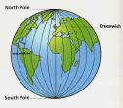
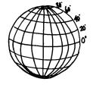
Map Skills
How do we find places on maps?

Slide 2
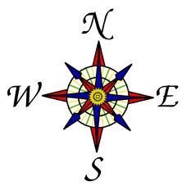
Vocabulary Term
Compass
Is a tool that helps the user know what direction they are going.

Slide 3
Directions on a Compass
Cardinal directions
Intermediate directions
North, South, East, West
Northeast, Southeast, Southwest, Northwest

Slide 4
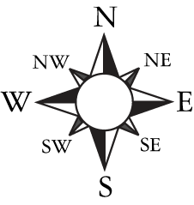
Directions on a Compass

Slide 5
Where is 0 degree?
Is 0 degree latitude.
imaginary belt that runs halfway point between the North Pole and the South Pole.
equator

Slide 6
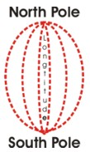
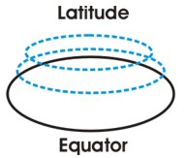
Imaginary Lines
Latitude and Longitude
The earth is divided into lots of lines called latitude and longitude

Slide 7
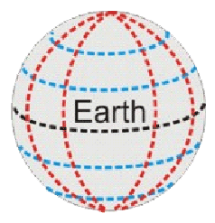
Lines
Longitude lines run north and south.
Latitude lines run east and west.
The lines measure distances in degrees.

Slide 8
Latitude
Lines run horizontally
Measures distance North or South from the Equator.
The Equator is 0 degrees Latitude.

Slide 9
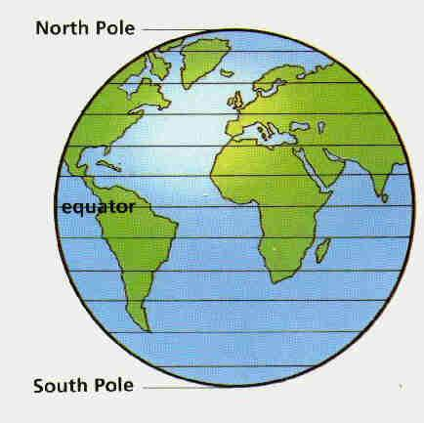

Slide 10
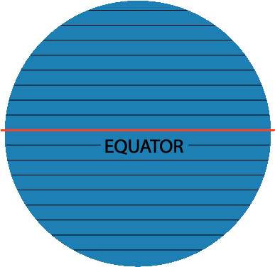
Latitude North Pole South Pole
90
80
Lines of North latitude are numbered from 0° to 90° are N.L.
[
70
60
50
40
30
20
]
Lines of South latitude are numbered from 0° -90° are S.L.
10
10
20
30
40
50
60
70
80
90

Slide 11
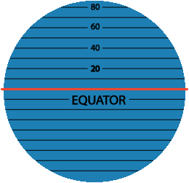
Latitude The North Pole is at 90° N The South Pole is at 90° S
The equator is at 0° latitude. It is neither north nor south. It is at the center between north and south.
40° N is the 40° line of latitude north of the equator.
40° S is the 40° line of latitude south of the equator.

Slide 12
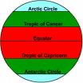
Major lines of latitude
North Pole
Arctic Circle
Tropic of Cancer
Equator
Tropic of Capricorn
Antarctic Circle
South Pole

Slide 13
Longitude
Lines of Longitude run vertically.
They are also called Meridians locate places East or West of the Prime Meridian.
There are 180 degrees of east Longitude, and 180 degrees of west Longitude.
The Prime Meridian is found in Greenwich, England and is 0 degrees Longitude.

Slide 14
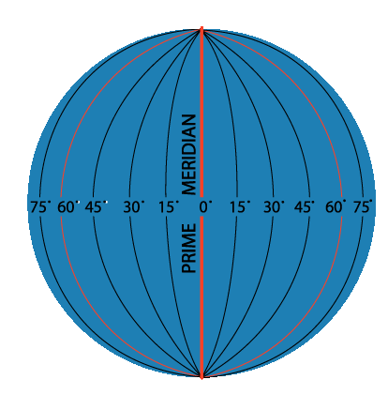
Longitude
Lines run vertically
Longitude lines are called Meridians
The main Meridian is called the PRIME MERIDIAN

Slide 15
Longitude Lines of longitude begin at the Prime Meridian.
60° E is the 60° line of longitude east of the Prime Meridian.
60° W is the
60° line of
longitude west
of the Prime
Meridian.
The Prime Meridian is located at 0°. It is neither east or west
W
E

Slide 16
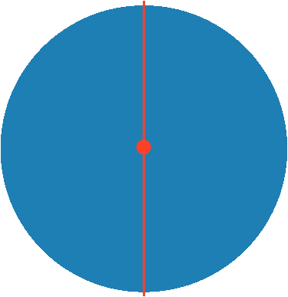
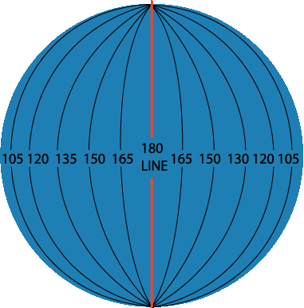
Longitude
180°
N
North Pole
W
E
West Longitude
East Longitude
PRIME MERIDIAN
S
Lines of longitude are numbered east from the Prime Meridian to the 180° line and west from the Prime Meridian to the 180° line.

Slide 17
Hemispheres
The Equator splits the earth into the northern and southern hemisphere
The Prime Meridian splits the earth into Eastern and Western hemisphere

Slide 18
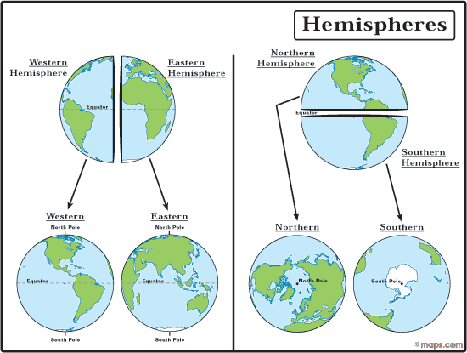

Slide 19
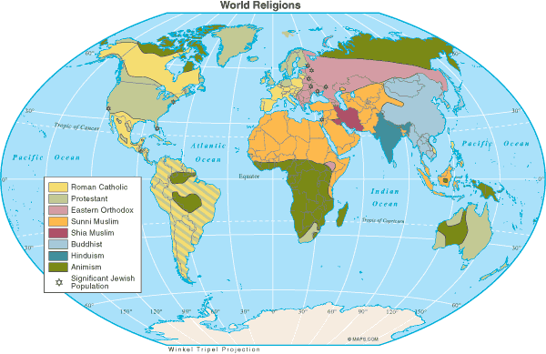
Map Legends/Key
Objects or colors in the legend represent something on the map.
Religions Legend

Slide 20
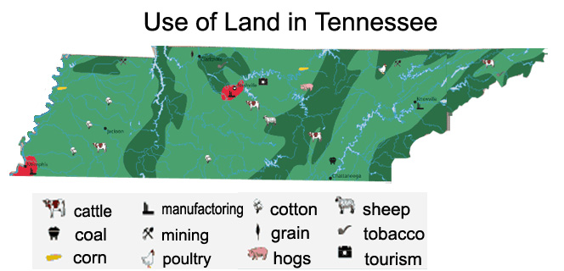
Can you understand this legend?

Slide 21
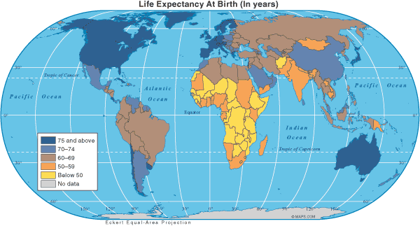
Age Expectancy
Legend

Slide 22
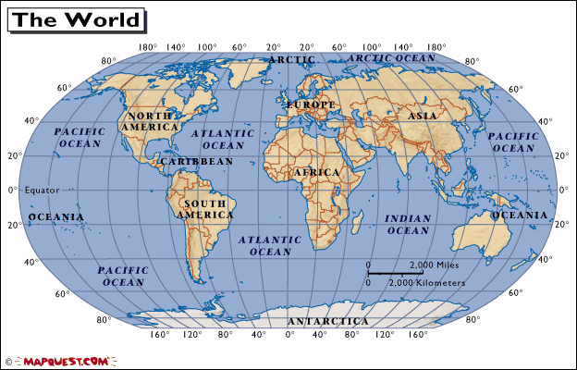
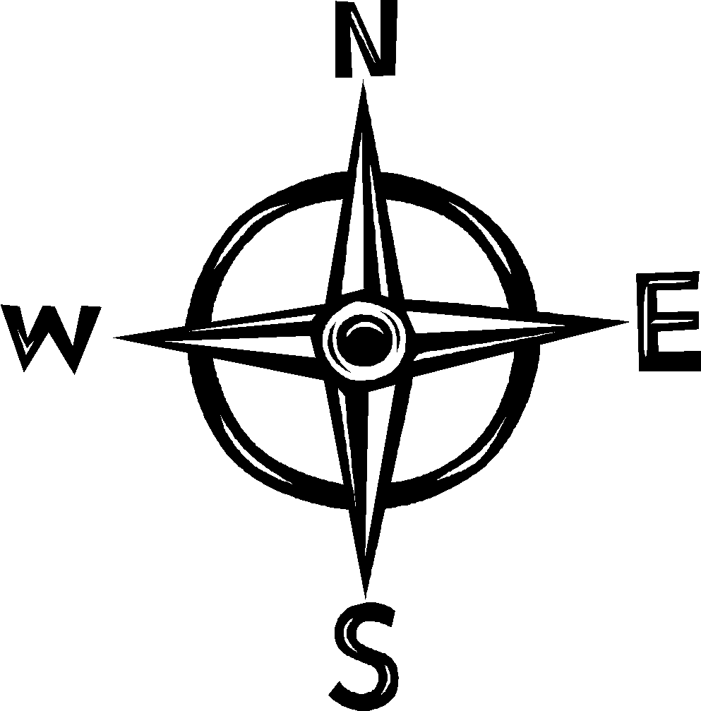
“How To” Foldable
Step #1:
Highlight the Equator YELLOW and Prime Meridian PINK
Step #2: Draw the Compass Rose in the bottom corner
* North, South, East, West, Northeast, Southeast, Northwest, Southwest
Step #3: Using the lines made by the highlighted equator and Prime Meridian to label the cardinal directions on the globe.
Step #4: Label the Hemispheres using the intermediate directions on the inside of the quadrant in the globe.
N
NW
NE
W
E
SW
SE
S

Slide 24
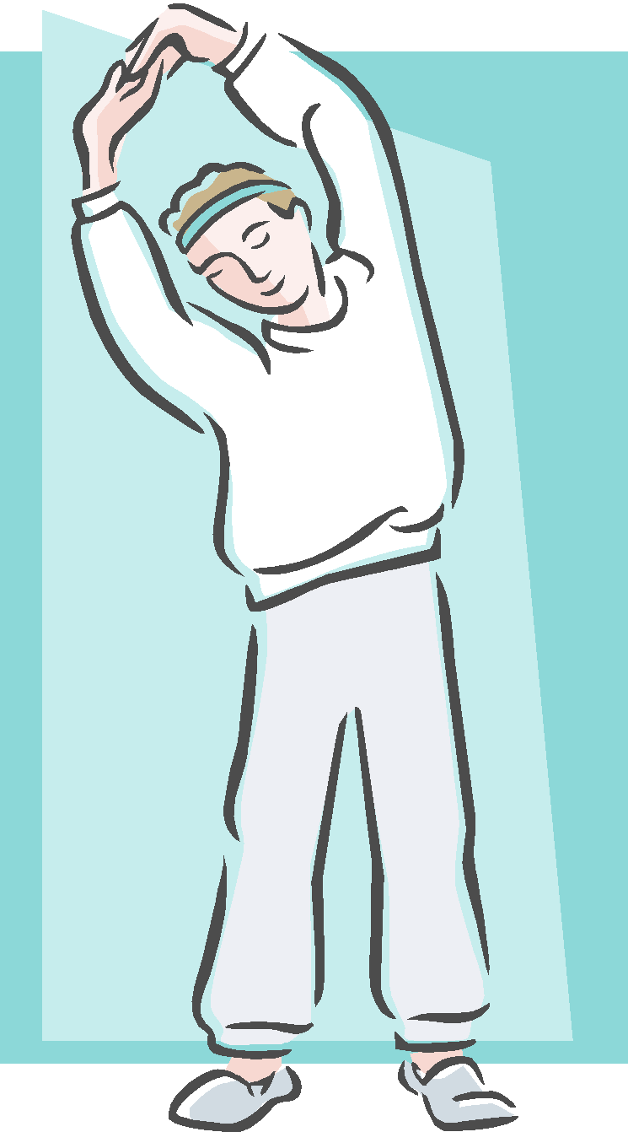
GLOBE SAYS
This game follows the same rules as “Simon Says”
Body parts represent the major lines of latitude
Top of head – North Pole
Ears – Arctic Circle
Shoulders – Tropic of Cancer
Waist – Equator
Knees – Tropic of Capricorn
Shins – Antarctic Circle
Toes – South Pole

