Slide 1
1. KSHATRIYA

Slide 2
2. UNTOUCHABLE

Slide 3
3. VAISYA

Slide 4
4. BRAHMAN

Slide 5
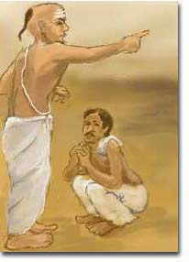
5. SHUDRA
Analyze this photo: To which class does the circled man belong? What led you to this conclusion?

